Slide 1
Citibike Analysis
Dimas Soeprapto

Slide 2
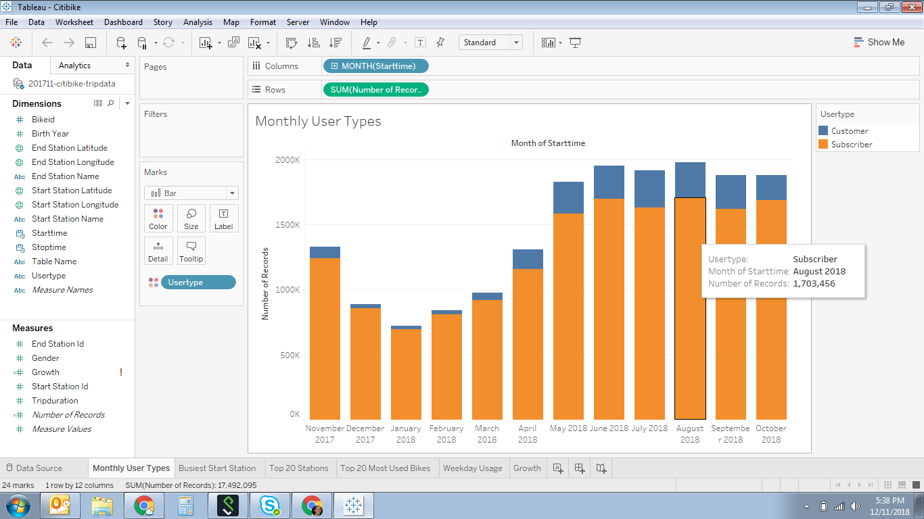
Usage has been stable in the past 6 months. There was a dip in January 2018 but later in April, it picked up close to the same volume as in November 2017. In average, one time customers make up 15% of subscribing customers.

Slide 3
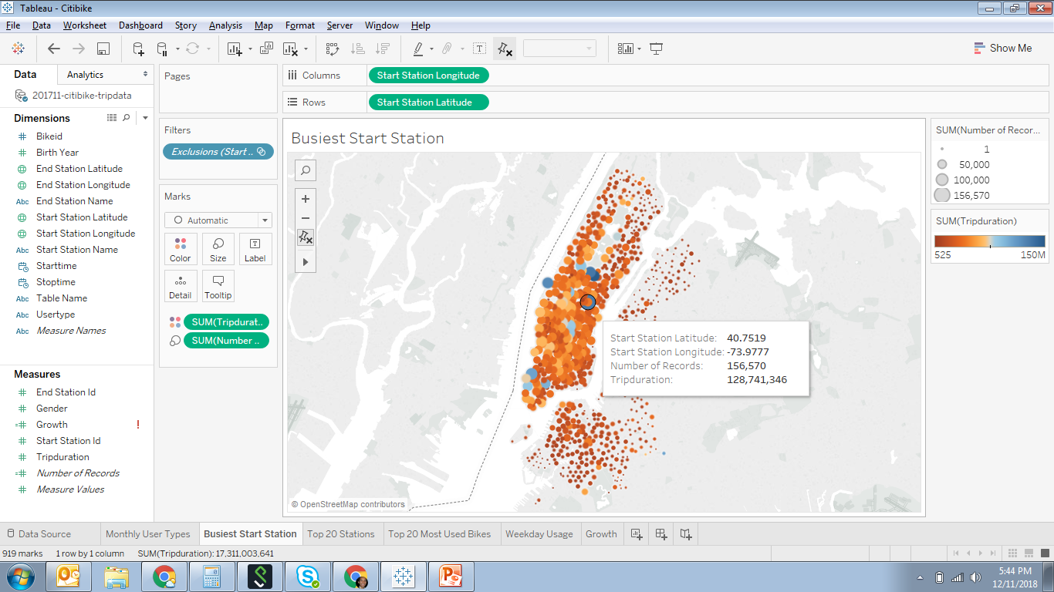
There are only few locations that are making up the majority of the volume. Volume is based on the origin’s total duration of trip in the last 12 months.

Slide 4
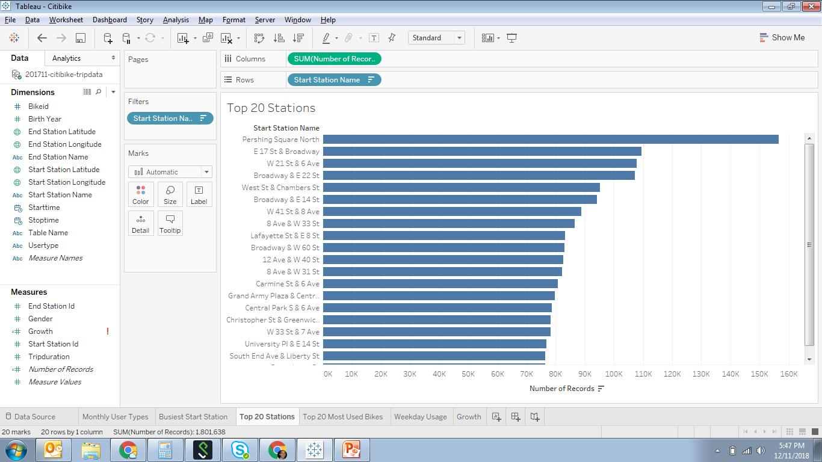
Expanding the previous slide, Pershing Square North has the highest volume (8.6% of total volume) based on the number of transaction being done at this location as the origin location. There are a total of 821 locations within the database for the last 12 months of data.

Slide 5
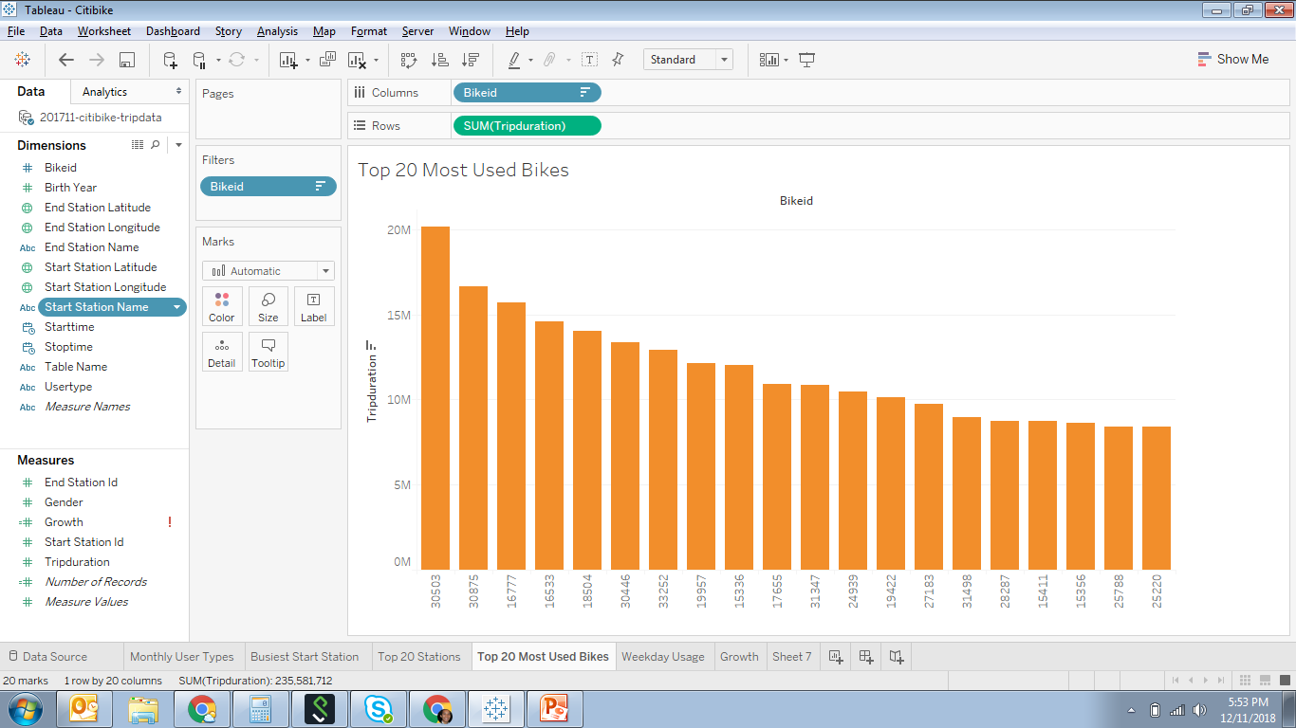
The most used bike is bike 30503. It has been used with a total duration of 20M minutes. That makes up 8.5% of total duration of all the active bikes. There are a total of 15k bikes within the database of the last 12 months.

Slide 6
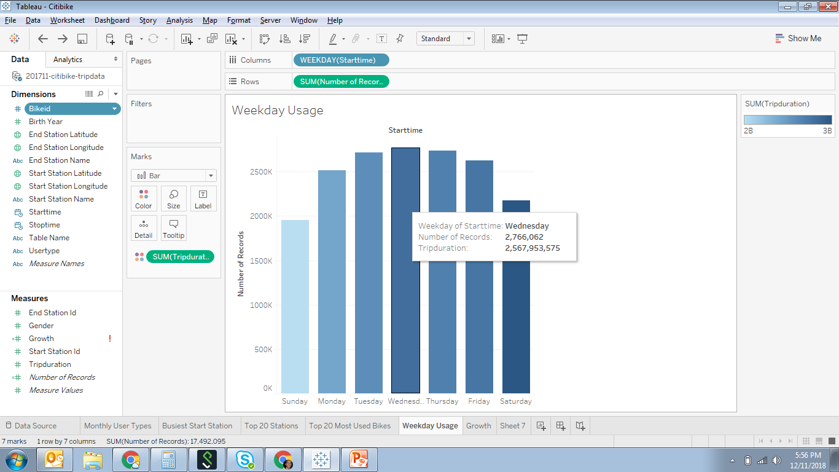
Wednesday is the busiest day for citibike rentals, but Saturday is the day where bikes are rented with the longest duration.

